Slide 1
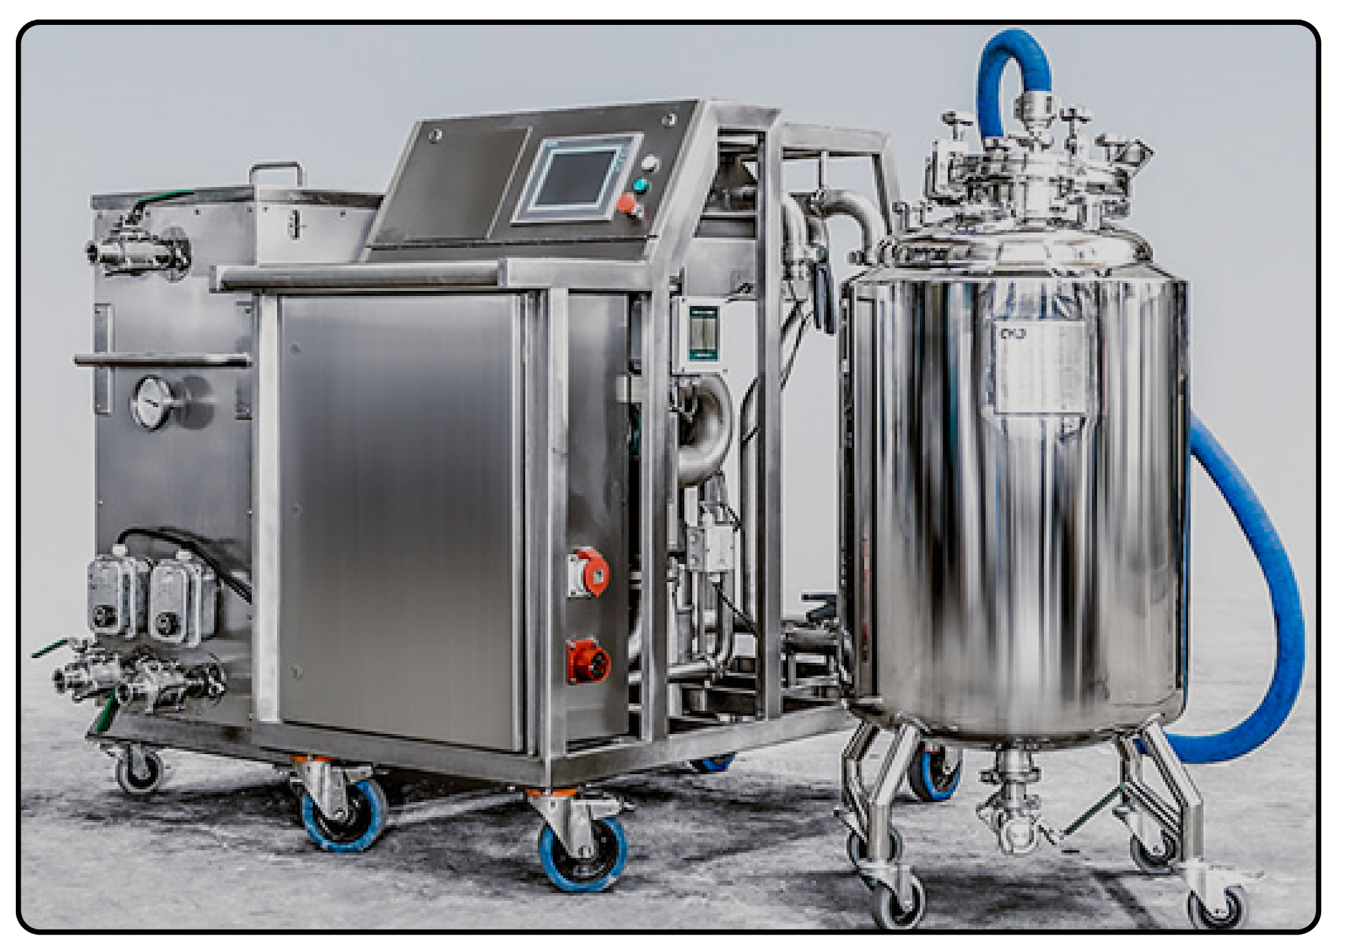

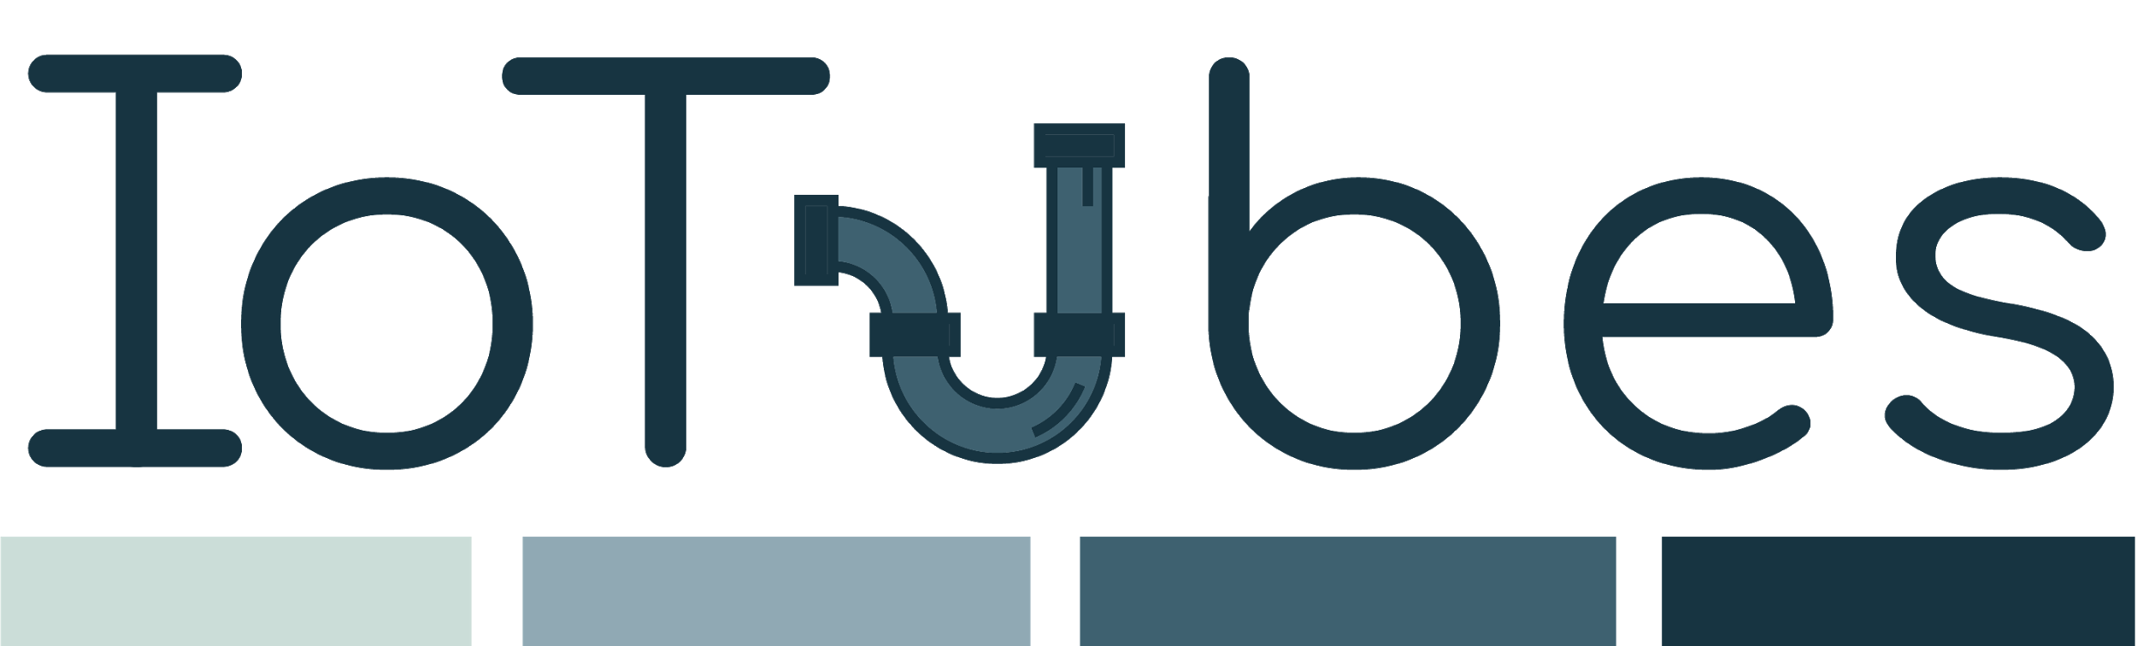
Mobile device for passivation, decontamination and resetting of industrial piping
Team 32
Christopher Wolfgang Wild s180026
Jakub Brzosko s161116
Manuel Montoya Catala s162706
Maria Katsimitsi s171869
Mathias Hald (CBS-maha16bf)
Notes:
Hello Everyone, thank you for coming here today,
We are team 32 and we would like to present you our start-up, IoTubes, developed in collaboration with the company CKJ Steel.
IoTubes brings more Digitalization in areas of the Pharmaceutical Sector, following the dream of the Industry 4.0 concept.
We provide machines with sensors and intelligence, and we provide our customers with an IoT ecosystem which implements various services that we will talk about later.
Lets focus on the specific situation that we have at hand:
No need to present the team members, there is a slide for that later if we have time

Slide 2
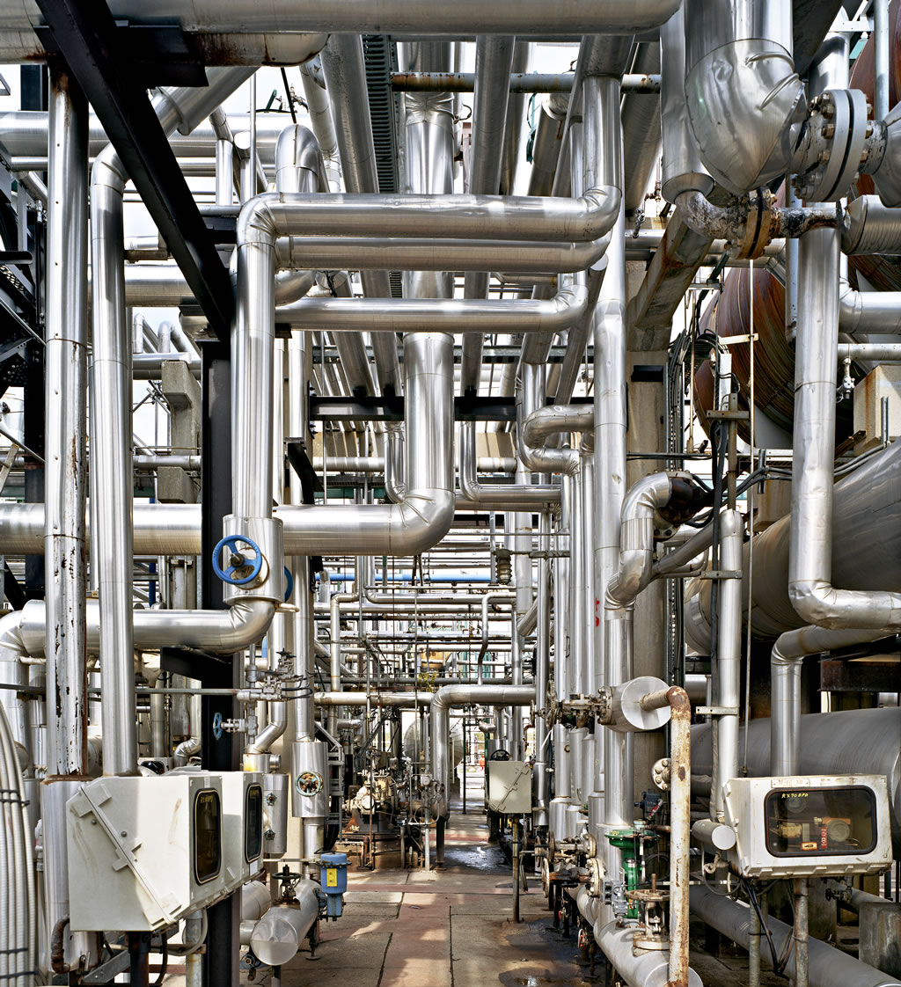
Problem
Production pipelines need cleaning every few days
The duration and reliability of the cleaning process is crucial for plant operation.
Stationary CIP units are costly, and have limitations
Notes:
Pharmaceutical companies (and others) have manufacturing pipelines where they elaborate their products, such as drugs.
Those need to be cleaned periodically, usually twice a week, while still being assembled.
How they are cleaned ? You have an external machine that pumps in an acid, a base, and water for some period of time, at a certain pressure and temperature. All of this being compliant with FDA standards.
The duration of the cleaning process being 4-6 hours.
The duration and reliability of the cleaning process is crucial for plant operation
Many pipeline systems are designed with an already existing stationary cleaning unit, called CIP.
But these are very costly, they serve only pipeline system, many of them don’t provide feedback from the system.
Industry would like a more flexible, and monitored cleaning system.

Slide 3
Product and features
Cleaning-in-place mobile machine
Passivation compliant with FDA
Mobility
Sensors and Intelligence
Added Value
Report generation
Increased safety
Live monitoring & adjustments
Notes:
Our solution is straightforward: Our product is a cleaning in place mobile machine
Compliant with FDA standards, so it can do all the high quality cleaning procedures
It is mobile, it can fit through doors so you can use in all the pipeline systems
And it comes with this sensors and intelligence that create this added value, provinding:
Automatic Report Generation
Increased Safety and Live Monitoring
The key features of our product can be seen here (Next slide)

Slide 4






Product and features
Safety
Digitalization
Cloud Services
Maintenance
Mobility
Fast Response
Notes:
These are the features that you will get:
First of all, safety, the keyword in the industry.
The monitoring of the cleaning procedure allows us to detect and solve critical situations, such as using the wrong chemicals.
We will provide a demo with a PH sensor, in which when the level is outside the allowed range, the system will send us an email.
Also the cloud services allows for automatic generation of reports and give an overview and control of the machines.
We also provide Maintenance of the machine through CKJ
And of course being mobile and fast response.

Slide 5
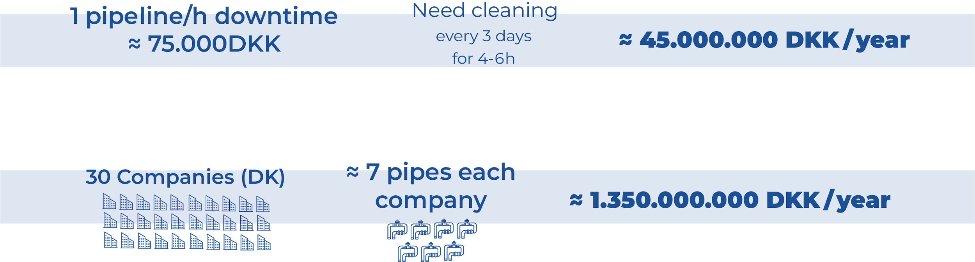
Market
Just in Pharmaceutical sector.
Food and beverages, chemicals productions etc are possible additions
Notes:
The pharmaceutical industry is quite closed up, it is very hard to get information about the costs.
From the several meetings that we had, we estimated the cost of an hour of downtime around 75.000 kr.
These need cleaning every 3 days, for around 4-6 hours, which yields around 45 million korner per year.
We also estimated that in Denmark there are around 30 companies with producition lines, with around 7 pipes per company.
Yielding over a billion KR of losses due to downtime.
This shows the importance that they give to the duration and reliability of the cleaning process.
From receipts of competitors we have seen that they are willing to pay 1/10th of this price in the cleaning procedure,
Giving a market of 100 Million Kr.

Slide 6
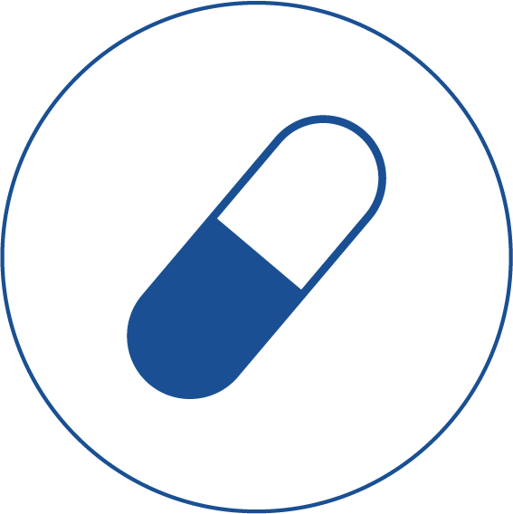
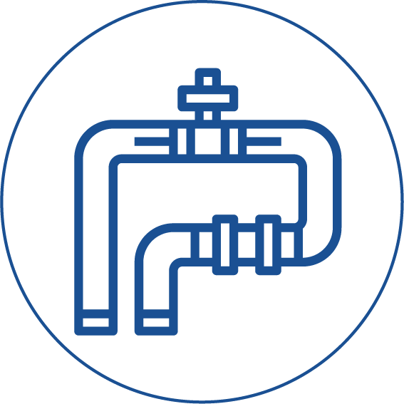
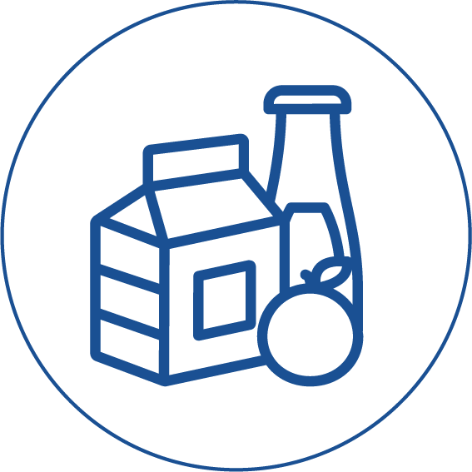
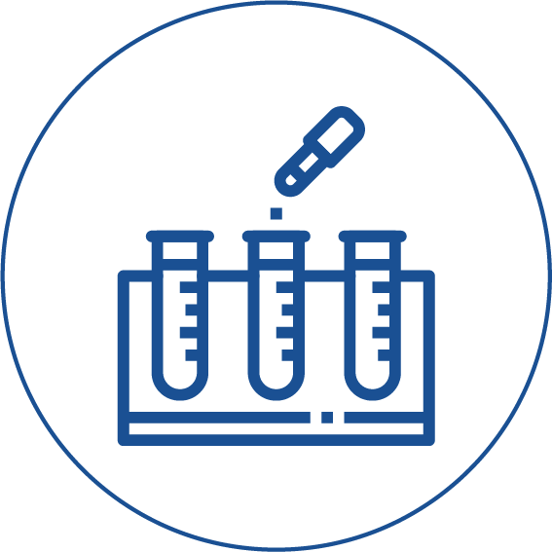
Customers
Pharmaceuticals manufacturers
Piping/ factory manufacturers
Food and drinks manufacturers
Test and research facilities
Notes:
The main customer sector are Pharmaceutical Manufacturers which require cleaning procedures compliant with FDA standards.
We can extend to other areas where it is not cost effective to have an in-place CIP or the monitoring degree of the cleaning process is not very high such as:
Piping/factory manufacturers (one time cleaning)
Test and Research facilities.
We can also supply other industries even though they do not require as high cleaning procedure as we offer.

Slide 7




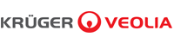
Competition
Mobile CIP for food industry:
Not applicable to Pharma industry
Passivation Underdeveloped
By-hand operations
Less reliable
No digitalization
Notes:
A mobile Cleaning unit is not a new concept so there are a few companies building these devices.
It is hard for other new players to enter the market since trust and reputation are keywords in this industry.
So how do we differentiate with them ?
The ones for Food industry such as AxFlow or Packo cannot handle the high pressure and acidic regulation of FDA.
Other companies such as Reci and Kruger do but they lack this amount of digitalization, they do their reports by hand.

Slide 8
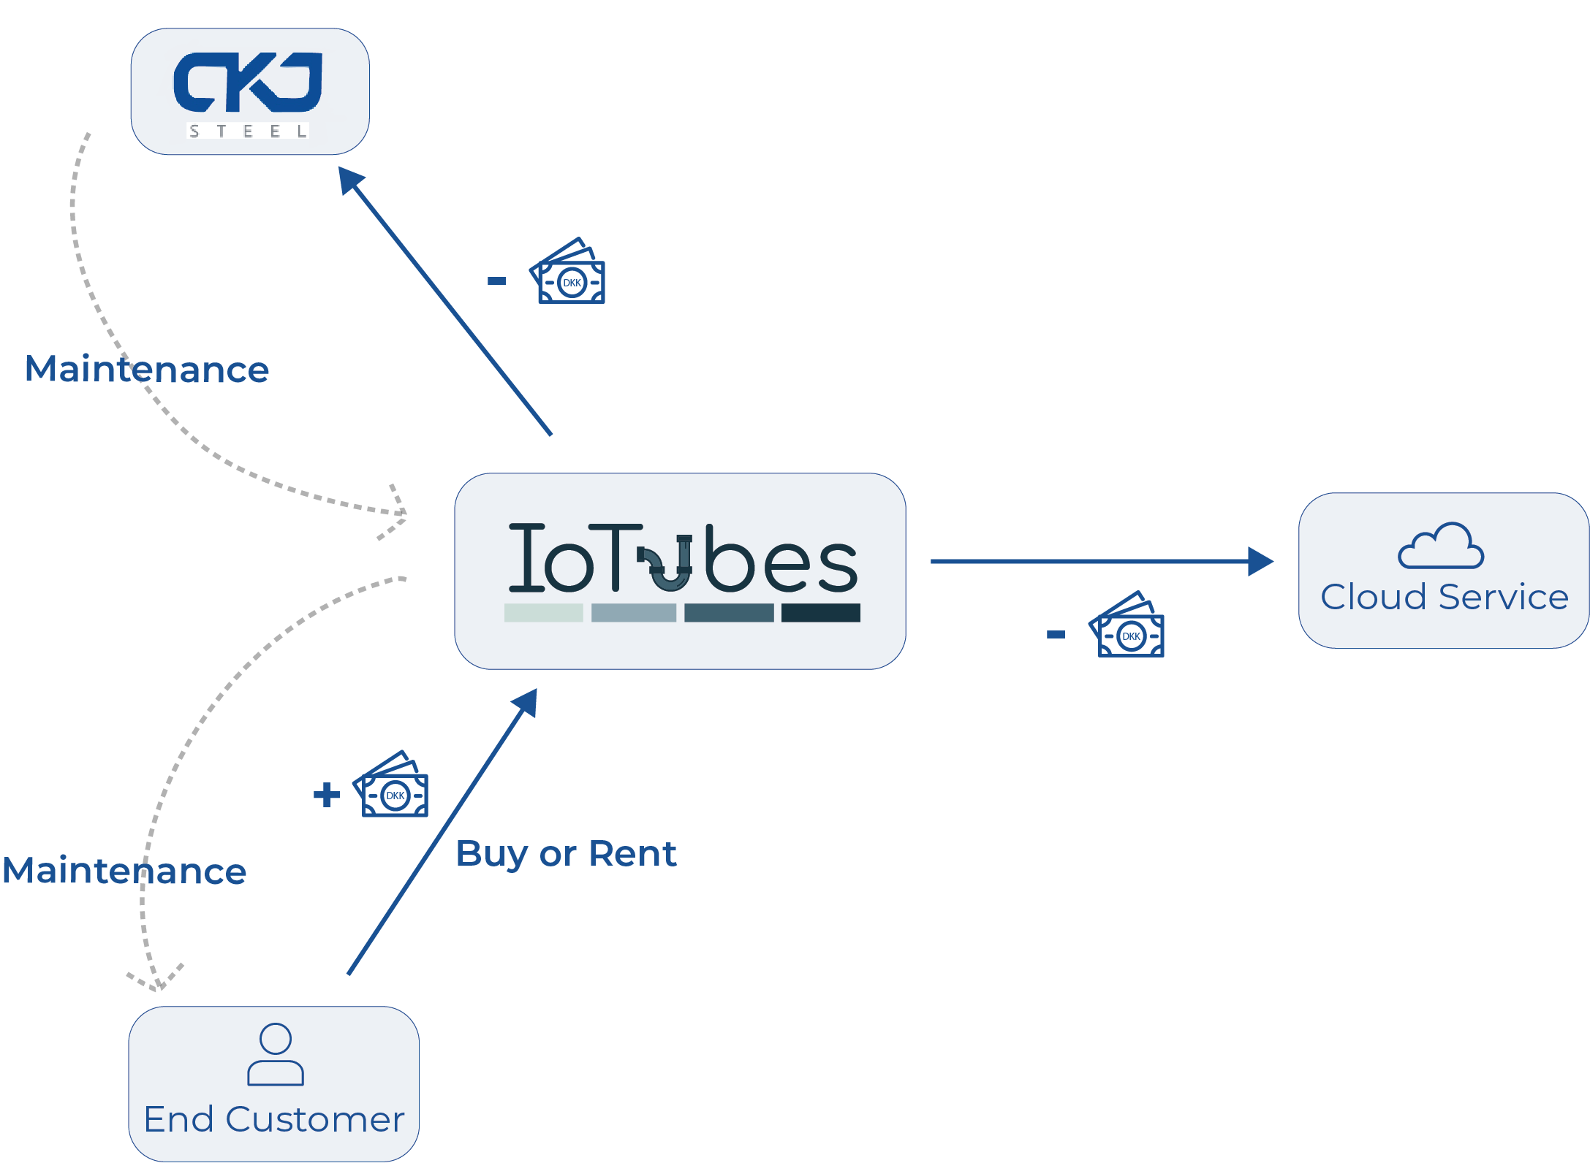
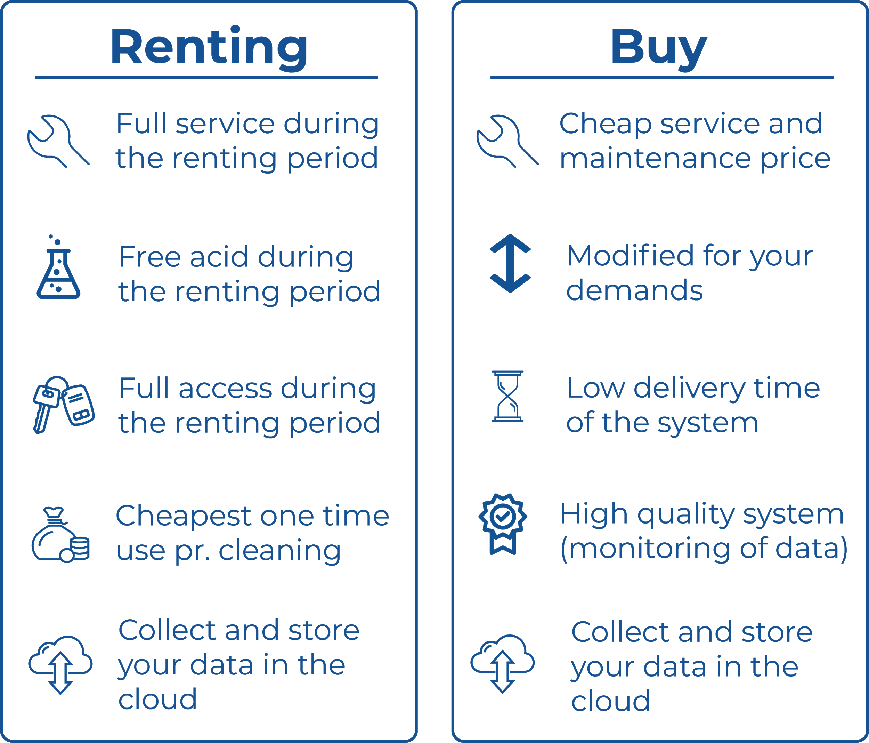
Business Model
Notes:
CHANGE GRAPHICS !! THE CLIENT pay US MONEY, AND WE PAY THE REST. there is no flow from CKJ to us, and no from cloud to us.
Our Business Model is simple:
We have a partnership with CKJ in which:
We buy the Basic Version of the CIP device.
They will get the direct connection to our customers through a service we will provide for either a maintenance subscription package or a general maintenance of the system check of those who want to buy the machine the elements of this Basic Version.
We include more Sensors to the machine and build the infrastructure to upload them into the Cloud Service that we implemented.
We charge customers for either buying or renting of the machine. They can use the Machine and the IT Cloud Services as they like. We offer them support with:
Maintenance of the machine: Which they will be managed by IoTubes but will be actually done by CKJ employes to which we will.
How to use the Cloud System: How to Visualize the Cleaning Processes, Machines, how to generate reports, upload files…
We are buying their expertise

Slide 9

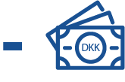
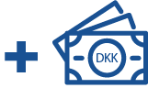
Finances
Negative accumulated
cash flows Y1 and 2
Positive accumulated cash flows in year 3
Negative cash flows financed by credit bank account
Notes:
We will only get problems with our liquidity in the first two years by 650.000 DKK. based on a budget where we buy 4 machines sell 2 of them and rent the rest Y1 And in Y2 we will buy 5 machines and sell 3 of them and rent the rest.
We will get countineously positive cash flows due to the budget in year 3
Based on borrowing of DTUs property and instead of buying a car we will rent a van when should deliver the product to our end customers

Slide 10
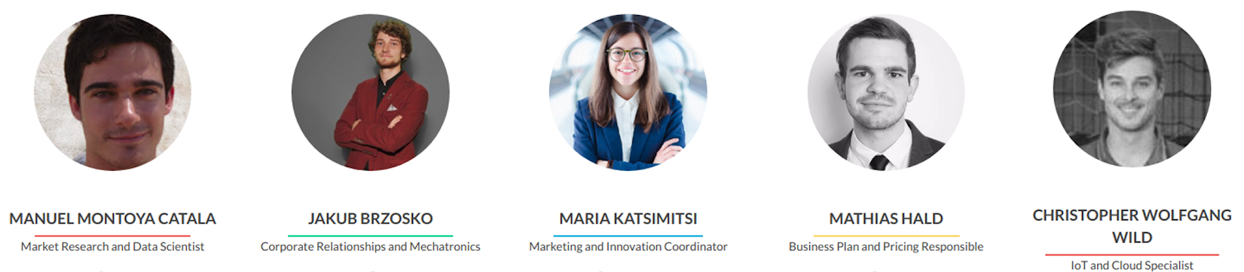
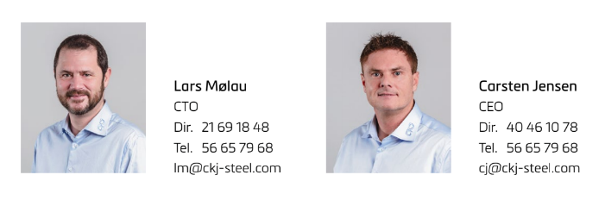
Team and Partners
Notes:
The IoTubes team is composed by 5 students, 4 of which are engineers from DTU and a Bussiness man from CBS.
Together we gather all the necessary technical and professional, hard and soft skill required for building a start up such as IoTubes.
Of Course we could not have made it without or partners from CKJ Carsten and Lars who supported us and gave us a great starting point for the project.

Slide 11
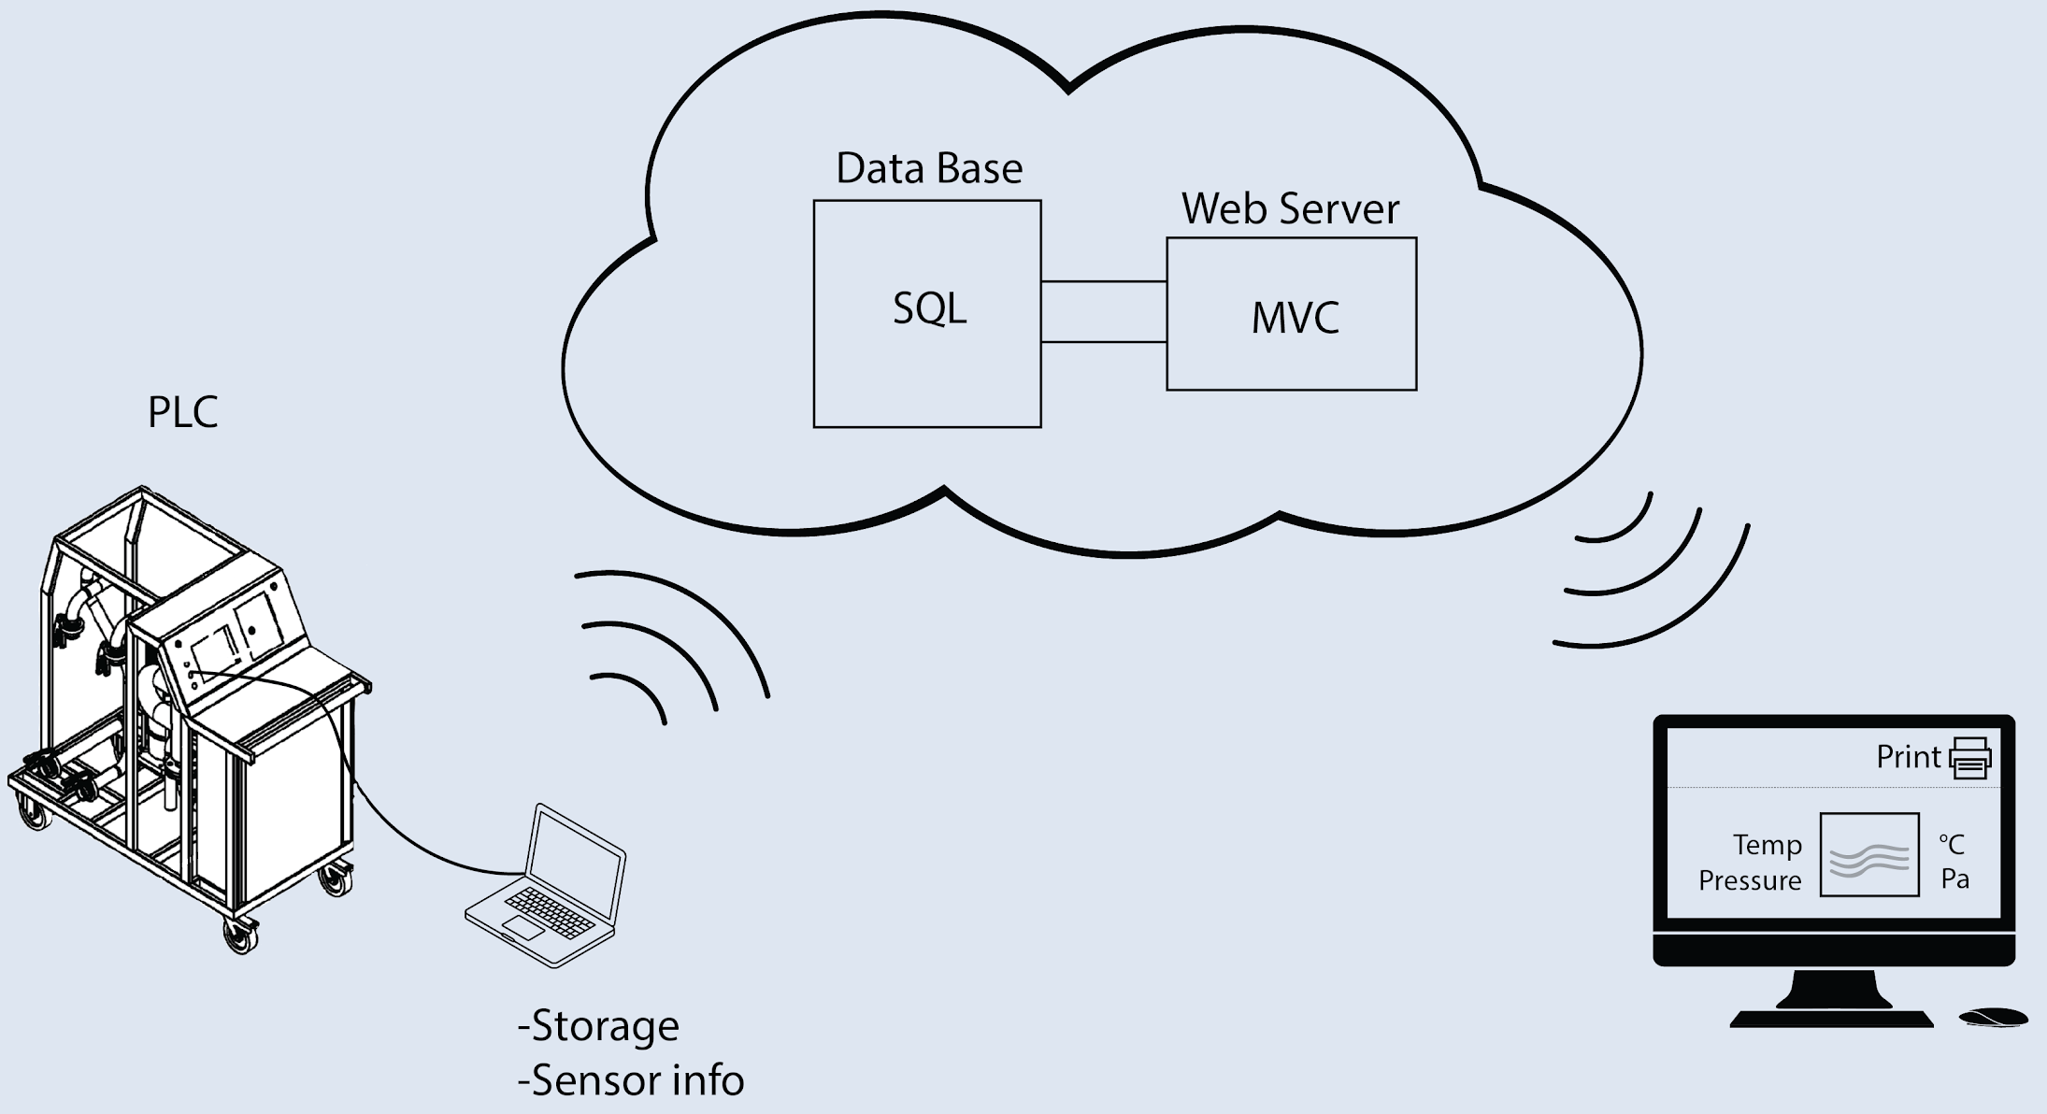
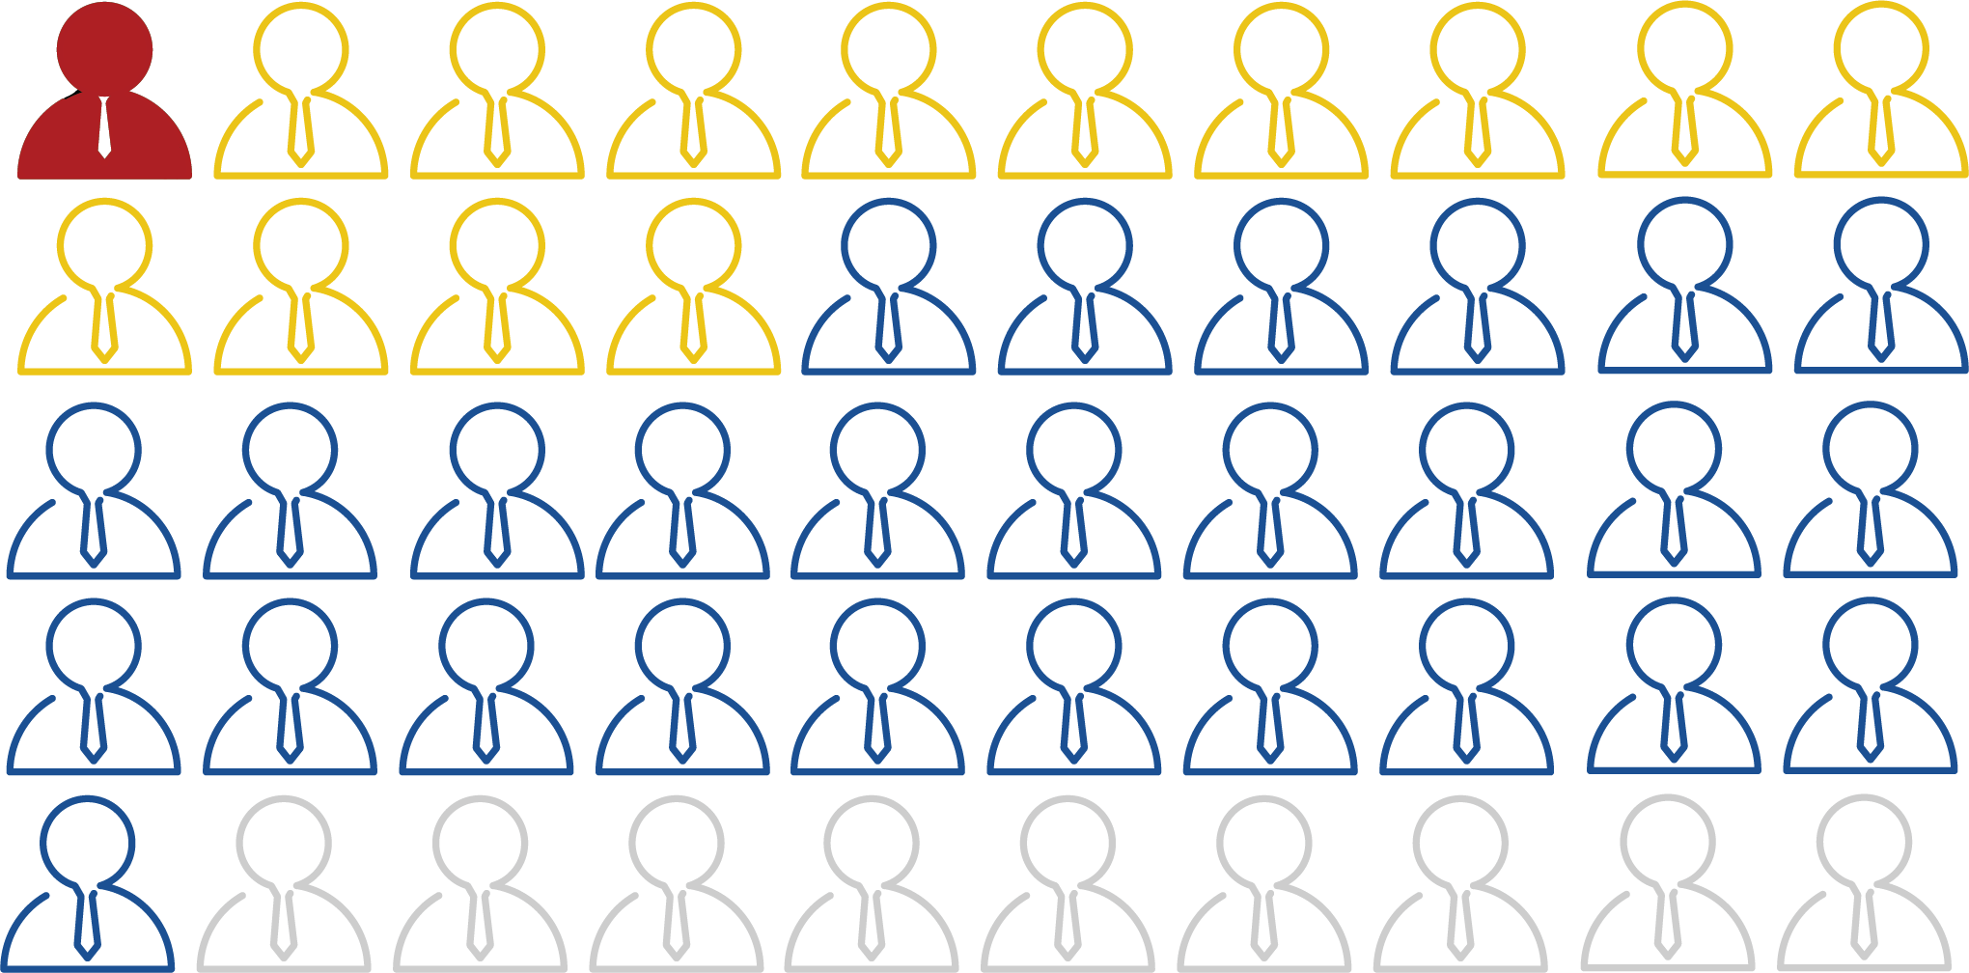
Traction
Commercial Website
Developing IoT solution
Designed SQL data structure
Data from the machine uploaded to the DDBB.
Flask Server visualizes data and reports anomalies.
50+ stakeholders contacted
29 stakeholders met
1 potential client
Hiring a team member with IT skills
Building a PH monitoring system
Notes:
We tackled the project from different angles:
Since promotion is essential for introducing a new product, we created a commercial website iotubes.dk with a modern Look&Feel in order to attract possible customers.
We wanted to add Digitalization to the machine so we created a flyer and post in several channels to get a new member with IT skills, Christoffer !
Since we could not have access to the machine to get the data. We bought Arduino and PH sensor (which the original machine does not have) to build a simulation system that we can use any time.
We developed an IoT solution in Python Flask + SQL to upload the data to the Cloud and further process it and visualize it
Since we were not provided with any previous market research, we wanted to really improve on that and we contacted 50+ stakeholders, and met Face to Face with 29 of them, out of which we have a potential client, Novozymes

Slide 12



Future Goals
Develop solution utilizing spectroscopy
Easily integrable IT system / API for consumer use
On site verification and review
Notes:
Of course within the time boundaries, budget and human resources that we had in this Course we could not develop everything we would like to.
Among the things we would like to we have:
Using a spectrometer sensor within the machine to better analyze the degree of cleaning. This would allow the machine to be used in other more high tech sectors.
Create a Webapp for using the Cloud Services of the machine. Why ? Because it is 2018.
Actually trying the improved machine and getting customer experience data.

Slide 13
Needs and Risks
Need:
Find a suitable gateway person that can get us inside the market
Better understanding of the way documentation should be handled
Investigate and assess how to differentiate more from competitors
Risks:
Not enough market size and reputation
Not enough added value to differentiate
Slow and costly development
Notes:
NEEDS:
One of the key struggles that we had is finding a proper entry point in the market, a person that knows the right people and could present our solution to the right stakeholders. When we contacted the big players such as Novo Nordisk, it was hard to be heard or trigger an actual action from them in the right direction.
Report generation and how these are compliant with FDA standards is also an area that we could not find that much information for and will influence the way the files are created, managed and stored.
Also we saw some similar competitors already acting in markets close to ours, so we need to think on better ways to differentiate from them in the future.
RISKS:
The market is very specific and has safety as main keyword, this makes it a quite expensive but very clustered market where reputation and trust are more important than Digitalization improvements in many cases.
The development of the IoT infrastructure and Webapps can be slow and costly.

Slide 14
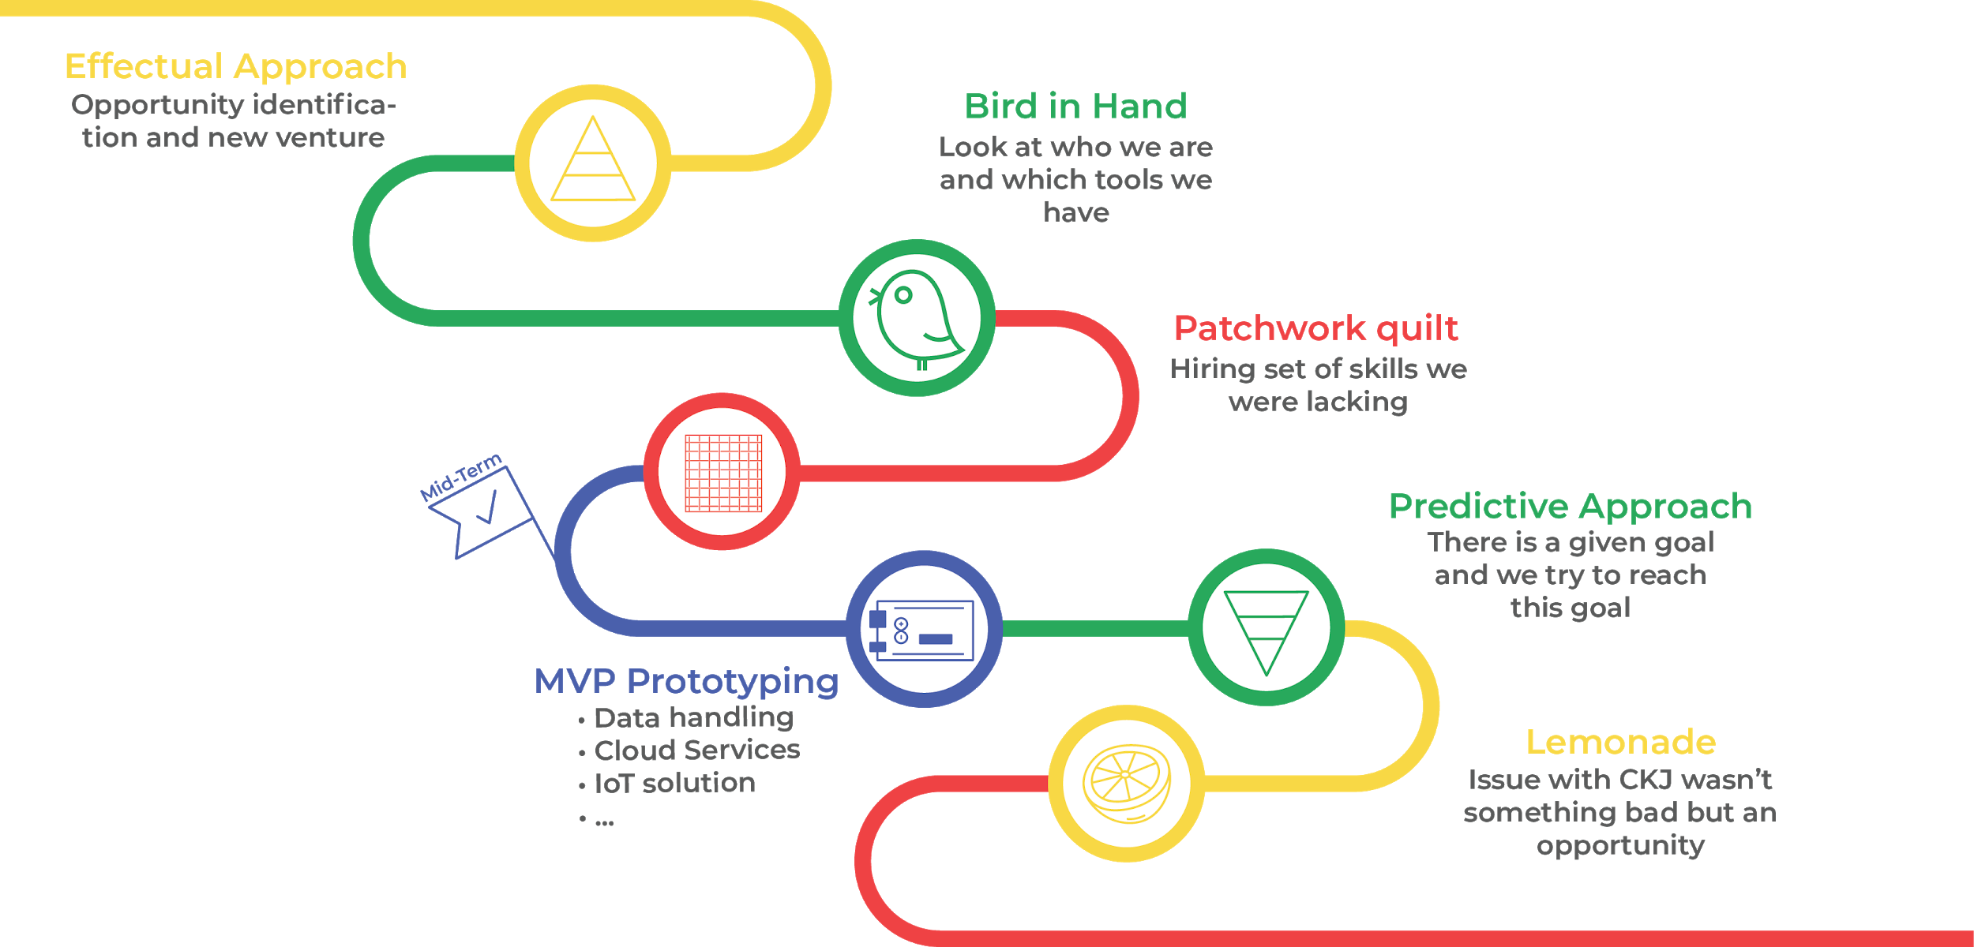
Project Progression
Notes:
In the beginning, we started to work on redrawing the given problem and searching for new opportunities within the problem space. After a while, we had the first replies for meetings from a variety of companies. Through these meetings, we were able to understand "who we are" and "what we know". That was the moment we have realised, that we miss some skills in our team, and we decided to hire. That helped us to move to the next phase. After the first milestone, we started to work on the MVP prototyping and more specifically on data handling, cloud services, and IoT solution. While we were developing the MVP prototyping we entered in a new phase, the Predictive Approach phase. The future for us was more predictable and as a result, we tried from the means that we had to achieve our goals. Finally, after a meeting with an external company, an issue with the CKJ arose. That led us to the opportunity to change the way we were contacting companies. More specifically, instead of saying that we are working with CKJ, we are saying that we are buying the piece of the equipment from CKJ and we built our cloud and IoT system on it.

